Slide 1
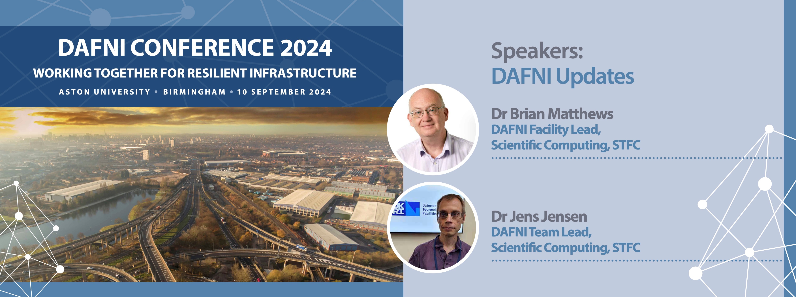
DAFNI Technical Update

Slide 3
Welcome to the 2024 DAFNI Conference: Working Together for Resilient Infrastructure

Slide 4
Welcome to the 2024 DAFNI Conference: Working Together for Resilient Infrastructure
To support scientific modelers in their technical collaborations
To foster new connections and collaborations in research
To spearhead new levels of transparency and reproducibility in model-based research
To facilitate communication of scientific results to non-technical decision makers

Slide 5
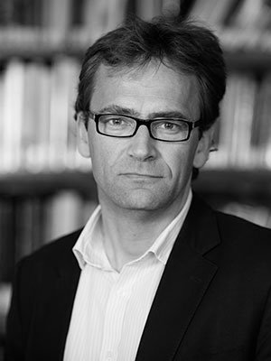
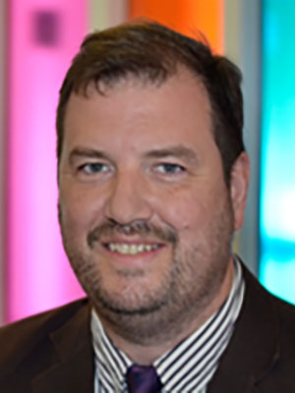
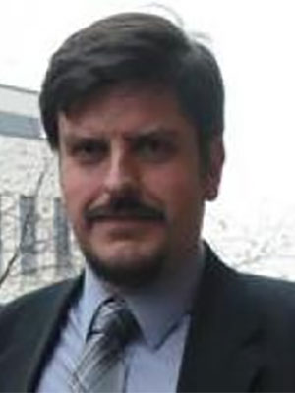
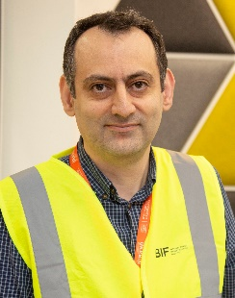
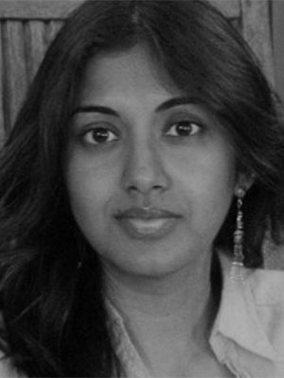
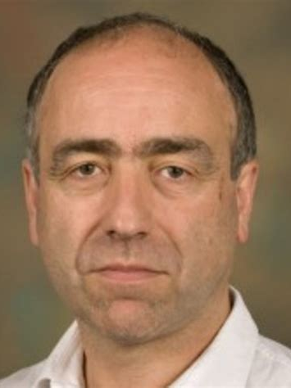
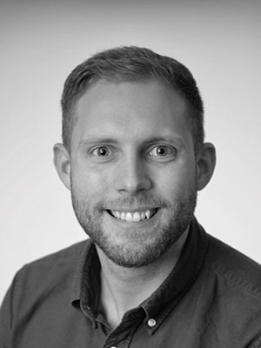
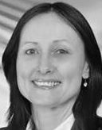
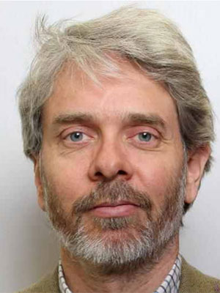
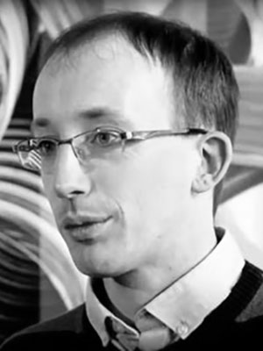
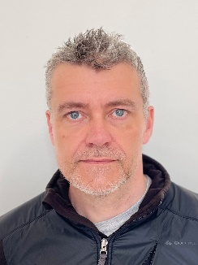
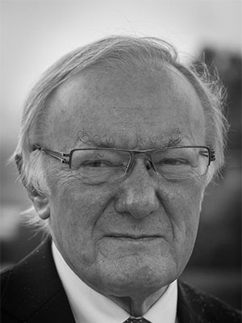
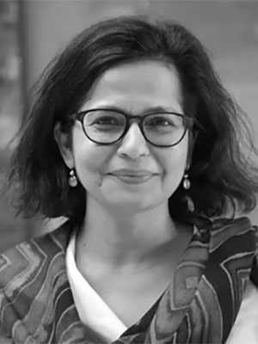
The DAFNI Partnership
Data and Analytics Facilities for National Infrastructure
Providing a computing platform for research into decision making for national infrastructure
UK Collaboratorium for Research on Infrastructure and Cities
Prof. Jim Hall
Uni. of Oxford
Prof. Stephen Hallett
Cranfield Uni.
Dr. Theo Tryfonas
Uni. of Bristol.
Dr Assad Faramarzi
Uni. of Birmingham
Dr. Aruna Sivakumar
Imperial College
Prof. Giuliano Punzo
Uni. of Sheffield
Dr Juan Bicarregui
STFC
Dr. Nik Lomax
Uni. of Leeds
Prof. Liz Varga
UCL
Prof. Julien Harou
Uni. of Manchester
Dr. Simon Blainey
Uni. of Southampton
Prof. Phil James
Uni. of Newcastle
Prof. Mike Batty
UCL
Dr. Ruchi Choudhary
Uni. of Cambridge
A Partnership of 12 universities and + STFC as development and hosting partner

Slide 6
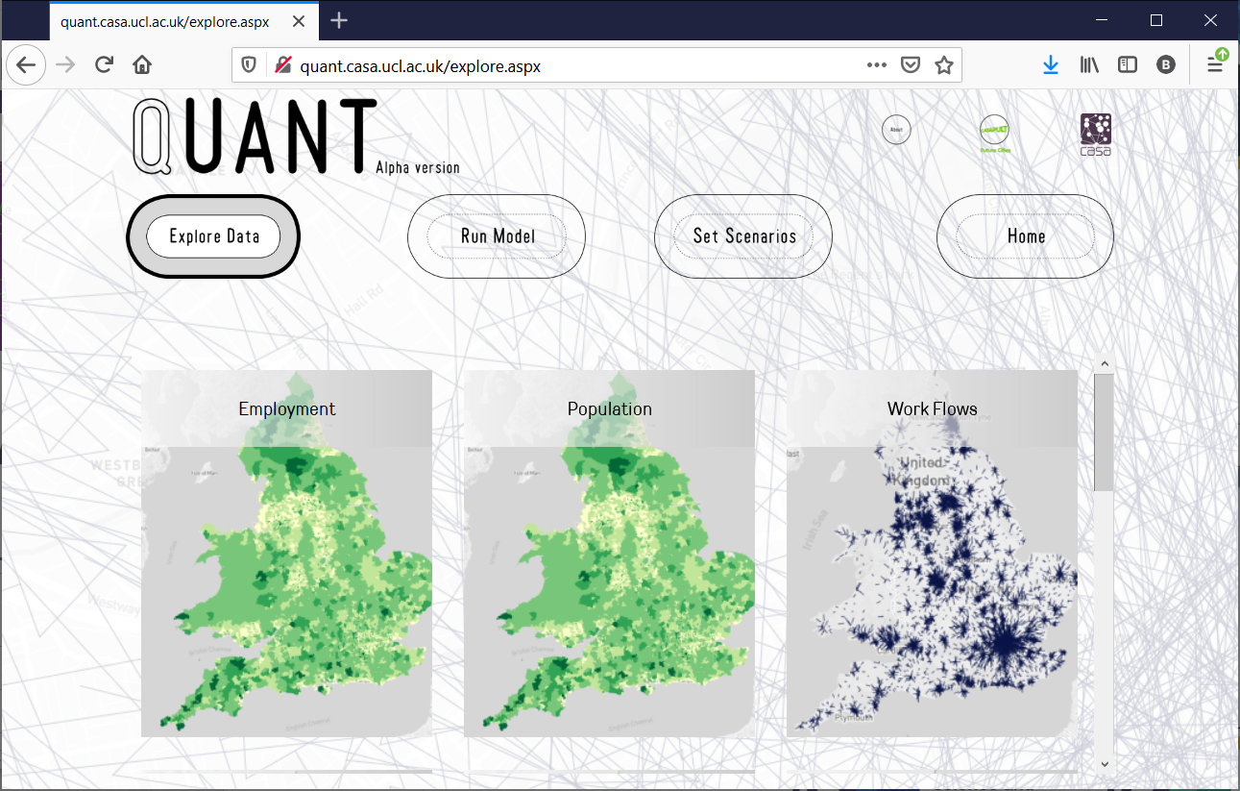
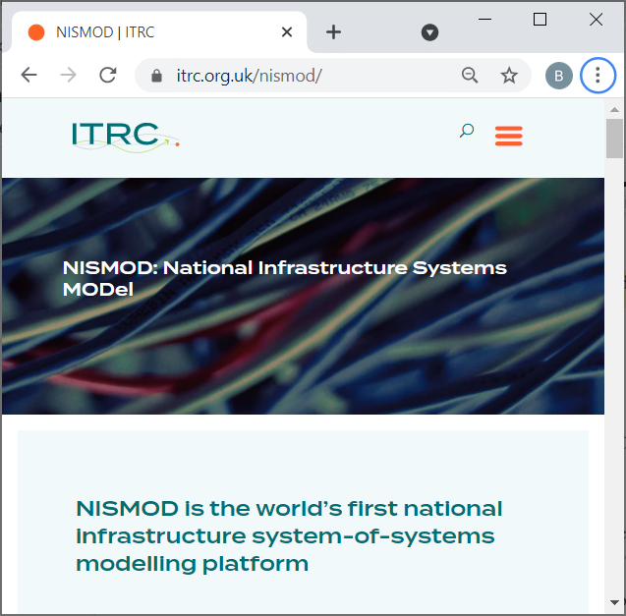
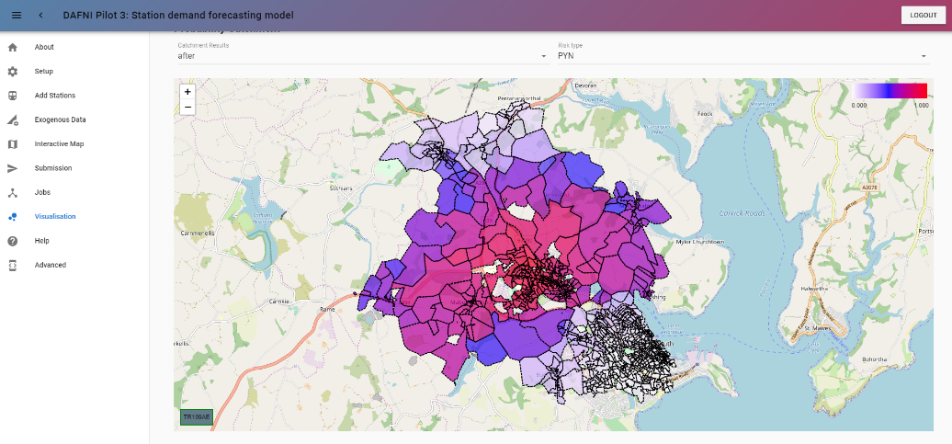
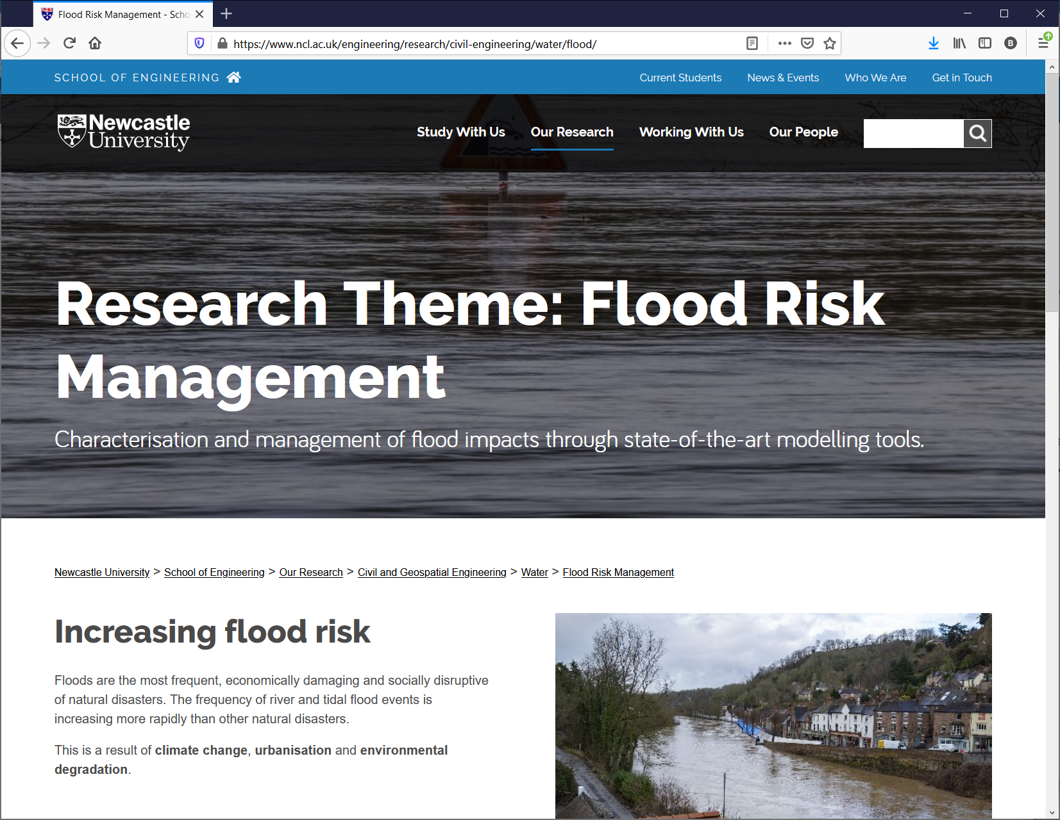
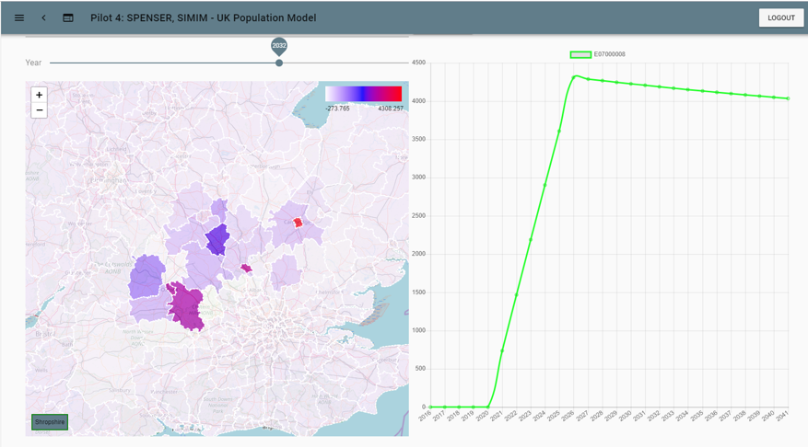
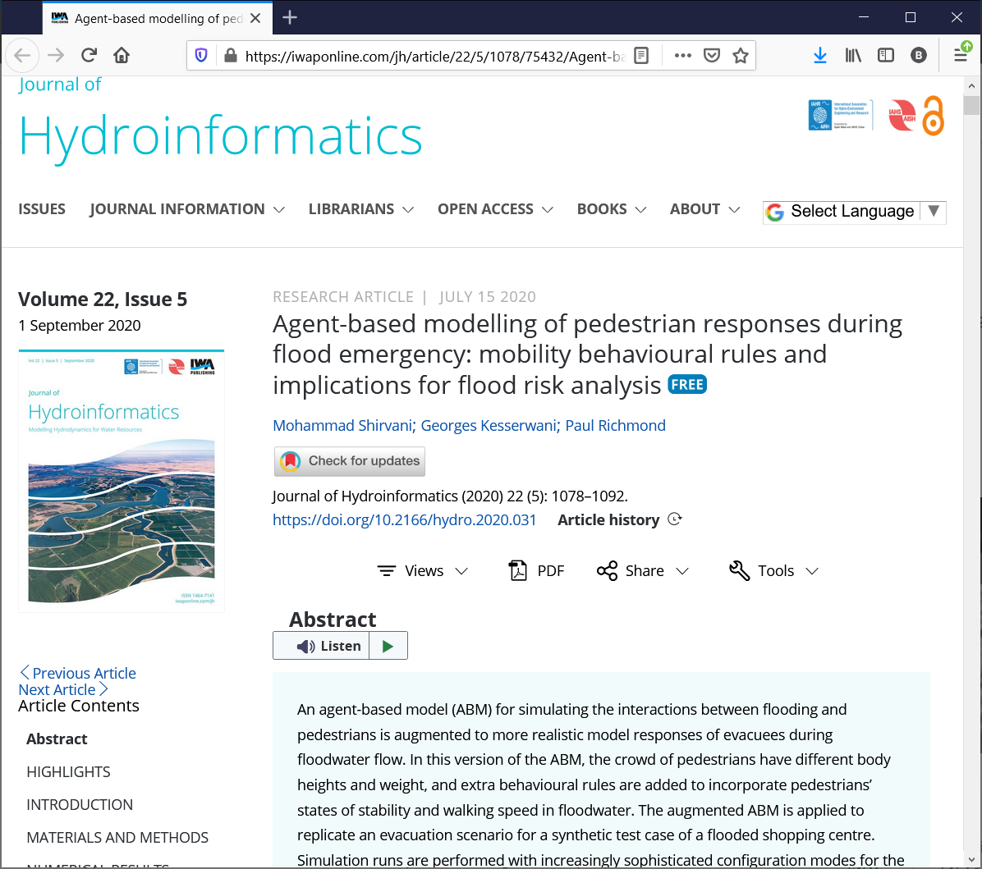
World-leading research
SIMIM, University of Leeds

Slide 8
Two Major Programmes
Building a Secure and Resilient World : The DAFNI Centre of Excellence for Resilient Infrastructure Analysis
Research Data Cloud Pilot: Data Infrastructure for National Infrastructure

Slide 9
The DAFNI Centre of Excellence for Resilient Infrastructure Analysis

Slide 10
Building and Secure and Resilient world
UKRI Strategic Theme
This funding aims to strengthen social and economic resilience, and enhance national security across virtual and physical spaces, by improving awareness of risks and threats; preparedness, decision making and response; and allowing change to be understood as a force for good

Slide 11
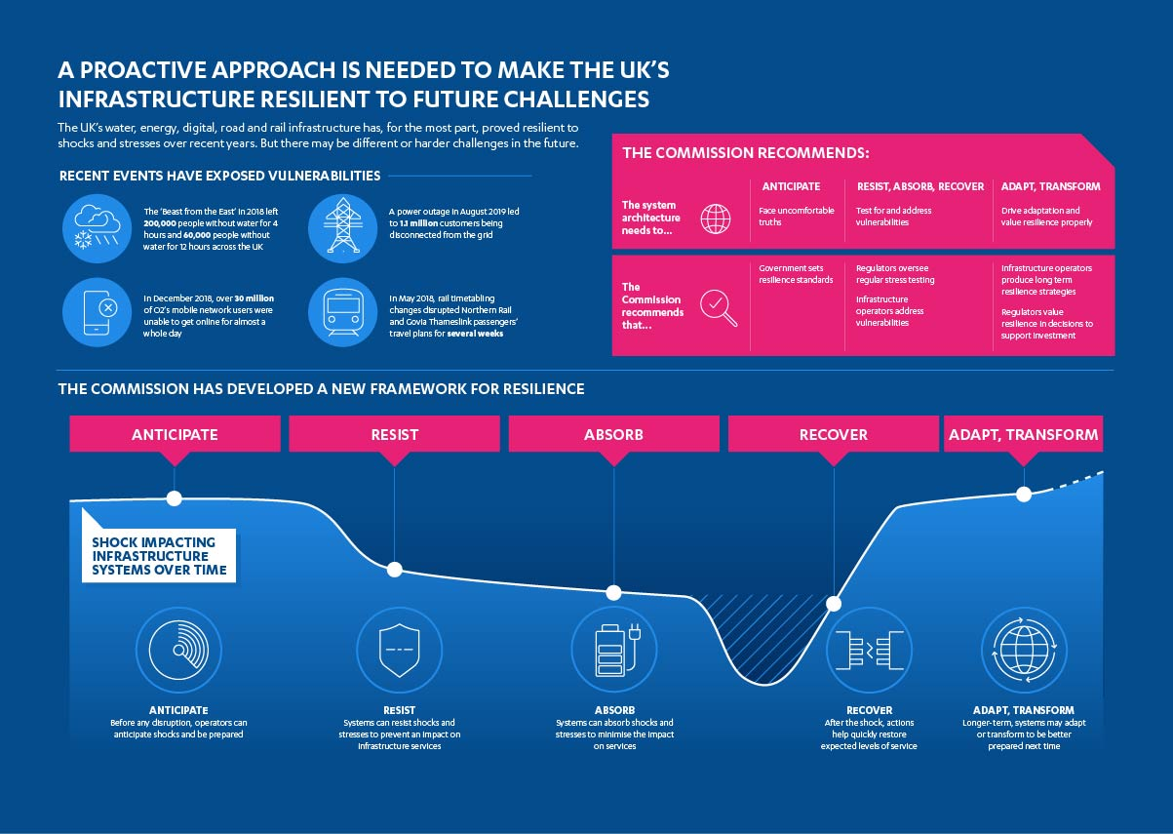
https://nic.org.uk/studies-reports/resilience/

Slide 12
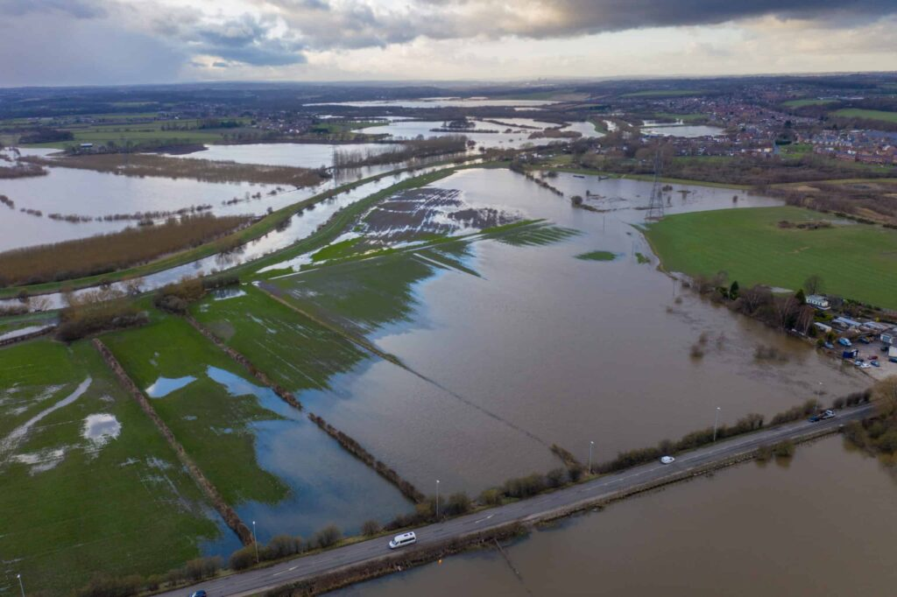
The DAFNI Centre of Excellence for Resilient Infrastructure Analysis:
Strengthening resilience in the natural and built environment in response to short-term and long-term threats via computational modelling
Resilience assessment and stress testing of infrastructure
Look at the knock-on effects of co-dependency
Consider the impact of change in other domains to the resilience of the infrastructure
Make tools available for use and re-use in new scenarios

Slide 13
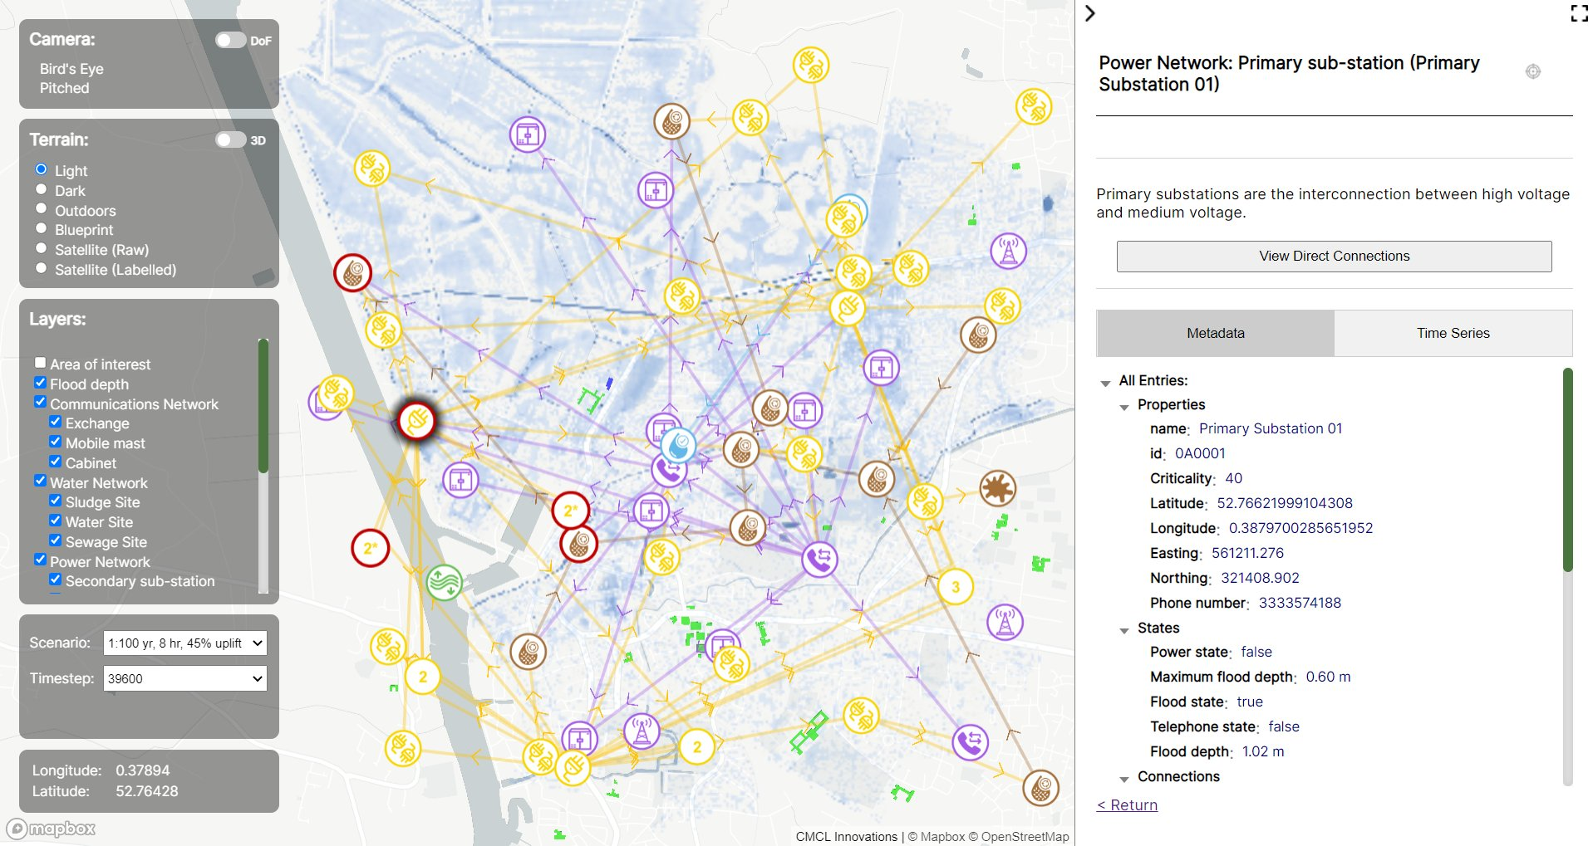
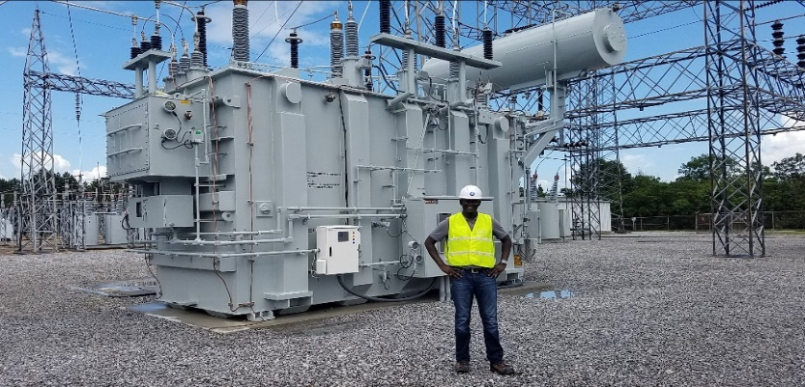
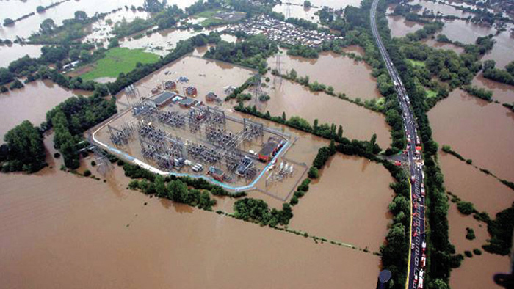
CReDo – Climate Resilience Demonstrator
The CReDo project aims to investigate the impact of climate change on infrastructure networks, and how we can mitigate the potential economic and social damage caused.
CReDo is currently focussed on the impact of flooding on infrastructure networks, possibility of interrelated sites going down. Evidence based decision support for flood mitigation was also provided.
DAFNI also facilitates secure data holding for BT, Anglian Water, and UKPN.

Slide 14
Research Programme
Three streams:
Supporting Key Models
Providing key resources to explore resilience
Developing a Resilience Framework
Providing tools to describe and measure resilience
Exploring Resilience Scenarios
Providing research demonstrators of resilience in practise

Slide 15
Objectives
Build on current DAFNI to form a Centre of Excellence in Modelling Resilience
Provide a centre of expertise and capacity to support computational modelling of resilience challenges for the BSRW programme
Provide a collection of compute and data resources to enable research in Resilience
Provide demonstrators to explore resilience to shocks via computational modelling on the DAFNI platform
To engage with the wider stakeholder community to exploit research into resilience
We need the engagement of the Research Community across all these objectives

Slide 16
BSRW Projects
Developing a Resilience Framework
USARIS Dr Francesca Pianosi, University of Bristol | Uncertainty quantification and sensitivity analysis for resilient infrastructure systems
Exploring Resilience Scenarios
STORMS Dr Xilin Xia, University of Birmingham | Strategies and Tools for Resilience of Buried Infrastructure to Meteorological Shocks
RIWS Dr Ana Mijic, Imperial College London | Resilience Scenarios for Integrated Water
SOFRAMODE Dr Vassilis Glenis, University of Newcastle | Sewer overflow flood risk analysis model DAFNI enabled
NIRD Dr Raghav Pant, University of Oxford | Systemic resilience of interdependent infrastructure networks at the national scale
Supporting Key Models
Pywr-WREW Dr Anna Murgatroyd, University of Oxford | A Water Resources model for England and Wales built in Python water resources simulation system
FIRM Prof. Richard Dawson, University of Newcastle | An agent-based model of flood infrastructure resilience – FIRM
SCQUAIR Dr Richard Milton, University College London | Small Changes and Computer-Generated Spatial Interaction Modelling with QUANT

Slide 17
BSRW/RDC “Sandpit” Projects
Transport
ClimaTracks Solutions (Rail) Giuliano Punzo, University of Sheffield; Ji-Eun Byun, University of Glasgow; Qian Fu, University of Birmingham; Tohid Erfani, UCL; Iryna Yevseyeva, De Montfort University; Kostas Nikolopoulos, Durham University | Forecasting resilience of railway network under propagating uncertainty
IMPACT (Road) Dr. Qiuchen Lu, UCL; Prof. Tao Cheng, Mr. Xuhui Lin, Dr Tohid Erfani, Dr Trung Hieu Tran | Improving flood disrupted road networks resilience with dynamic people-centric digital twins
MARS (Airports) Fabian Steinmann, Cranfield University | Flight Diversion Modelling for the UK Aviation System
Energy
D-RES Desen Kirli, University of Edinburgh; Laiz Souto, University of Bristol | Provision of distributed grid resilience using EVs during extreme weather events
ForNET Kostas Nikolopoulos, Durham University; Lu Yang, York St John University; Haoran Zhang, University College London | DAFNI Forecasting Services for Energy Networks resilience using EVs during extreme weather events
BRINES Hannah Bloomfield, Newcastle University; Sean Wilkinson, Newcastle University; Ji-Eun Byun, University of Glasgow | Building risk-informed redundancy in energy systems transitioning to net-zero

Slide 18
Developing the CoE
Projects will get underway from October onwards
DAFNI will be supporting them and helping them work together.
Will also be working with other projects in the programme
Especially the Research and Coordination Hub​
Planning events
Including next year’s DAFNI Conference!
Extending the coverage
Workshops and Sandpits
Transport, Energy, Telecommunications
Funding small exploratory studies

Slide 19
Data Infrastructure for National Infrastructure

Slide 20
Data Infrastructure for National Infrastructure : Background
Department of Science Innovation and Technology (DSIT) are undertaking a pilot initiative to address barriers to data sharing (the Research Data Cloud Pilot project - RDCP).
The overall objective of this activity is to test and understand the need for a national research cloud through a series of interventions designed to remove data sharing barriers, in order to identify potential models and options for future national scale initiatives, and to build an investment case and set out the role of Government.
Restricted call for Pilot projects within the UKRI Digital Research Infrastructure programme August 2023.
The pilots to provide evidence on :
optimise the research data ecosystem in the UK
ensure researchers have secure access to the highest quality data
cement the UK’s status as a world-leading research hub
Four projects were selected:
Data Infrastructure for National Infrastructure (DINI) – or DAFNI-DINI
FAIR-Accelerator
EDS-Boost
Passport

Slide 21
DINI – a Research Data Cloud Pilot
Department of Science, Innovation and Science are undertaking a pilot initiative to understand the need for a UK Research Data Cloud
DAFNI-Data Infrastructure for National Infrastructure (DINI), is focussed on exploring the barriers and opportunities for data sharing in national infrastructure systems
Water, Energy, Transport
Pilot objectives:
Situation analysis
Data publication support
Enabling services
Benefits realisation

Slide 22
Data Sharing in Infrastructure Systems Research
The Infrastructure Systems Engineering Research community has some characteristics:
Data comes from industry or government rather than other research
For impact, researchers need to share results with stakeholders in government and industry
Some data can come under the security category of Critical National Infrastructure
High diversity in data sources, formats and semantics
Highly interdisciplinary – interacting with environmental sciences, social and economic data, health data etc.

Slide 23
Barriers to Data Sharing
The National Infrastructure Commission in 2017 identified five types of barriers
Privacy and legal barriers
Sharing and use of personal data.
Non-personal data is generally less affected but cultural and commercial barriers can occur.
Security barriers
sharing data may lead to security breaches, data losses and potentially high-impact cyber-attacks.
Commercial barriers
the costs of sharing are perceived to be greater than the expected benefits, or
sharing data may be perceived to entail a loss of competitive advantage.
Cultural barriers
habits, policies and attitudes within organisations that oppose data sharing.
Technical barriers
the data not being in the right format, semantics, metadata, access
Data sharing in infrastructure, a New Technologies Case Study. Prepared by Deloitte for the National Infrastructure Commission, 2017. https://nic.org.uk/studies-reports/new-technologies/data-sharing-in-infrastructure-2/

Slide 24
DAFNI-DINI – What we are doing
Landscaping analysis on Opportunities and Barriers to Data Sharing
Literature review
Surveys
Workshops
Interviews
Case studies
3 DAFNI Champions
Case studies from the User Projects
Exploring technologies
Interoperating DAFNI and JASMIN
APIs for data with Energy Data Centre and with NOMIS
Synthesis and recommendations

Slide 25
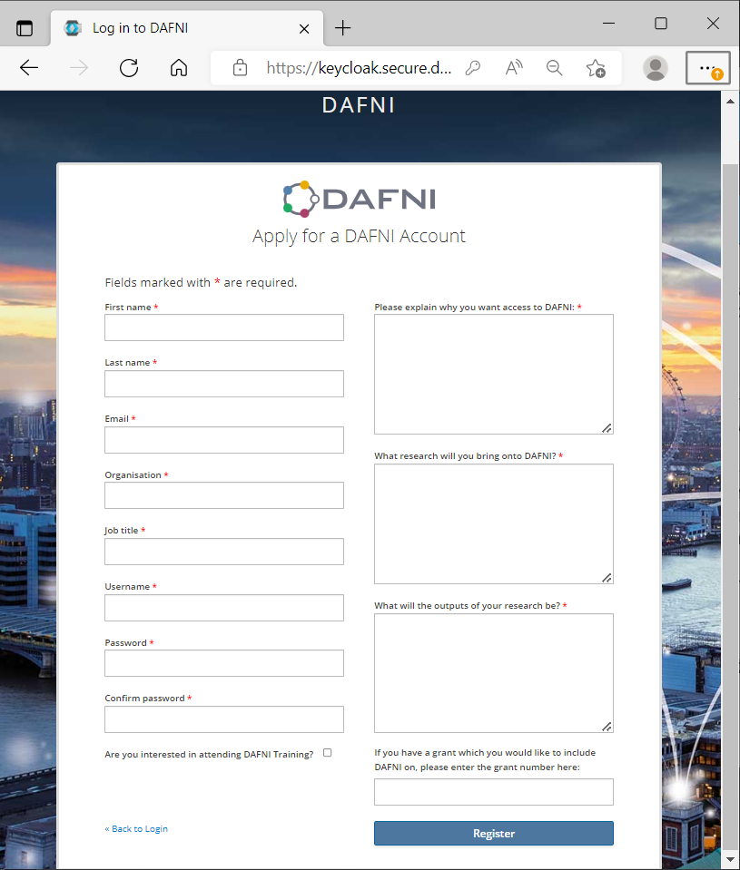
Accessing DAFNI
Access to DAFNI is FREE to UK Researchers
Also as a facility in JeS
Trial accounts for others on application
Also inclusion on Research Grants
Talk to us
info@dafni.ac.uk
www.dafni.ac.uk
Sign up to the Newsletter

Slide 26
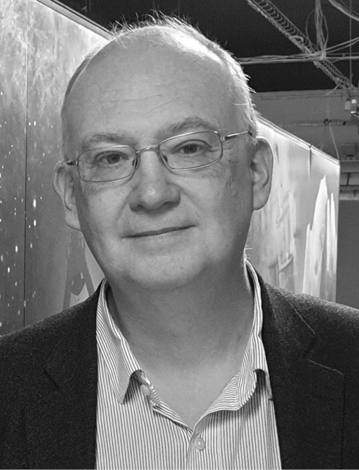
Thank you
Dr Brian Matthews
Brian.Matthews@stfc.ac.uk
www.dafni.ac.uk
info@dafni.ac.uk
DAFNI Conference, Aston, 10 September
https://www.dafni.ac.uk/annual-conference-2024/

Slide 27
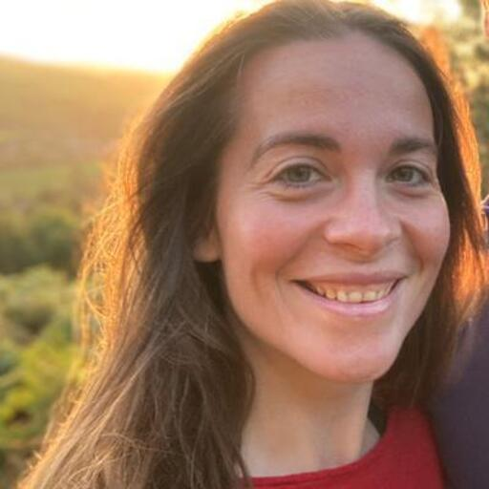
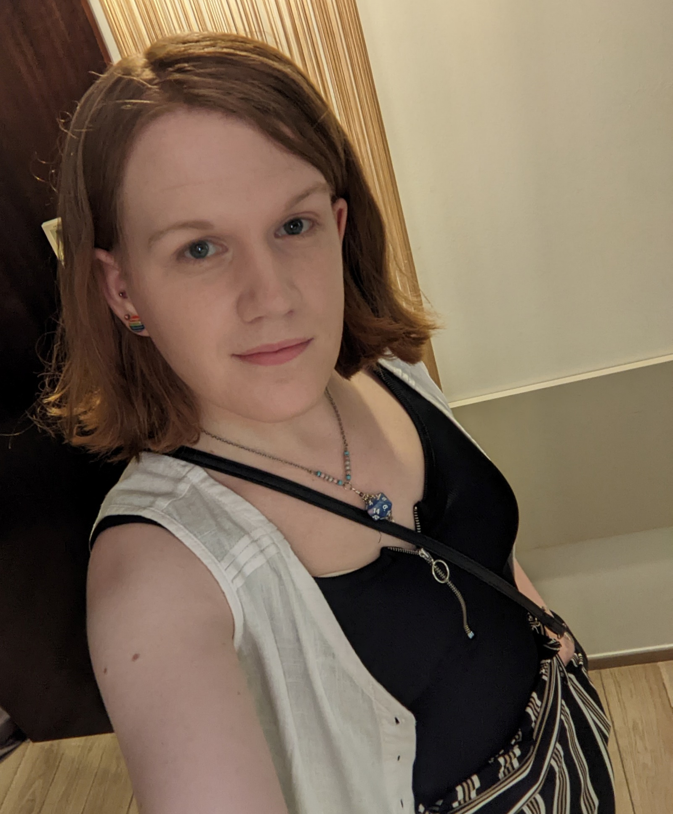
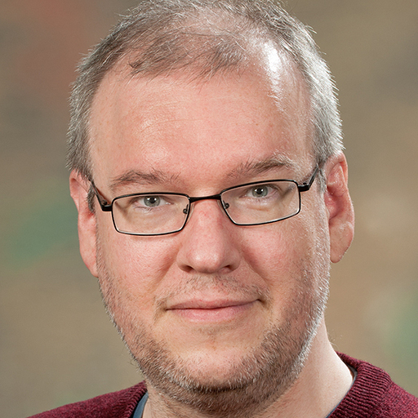
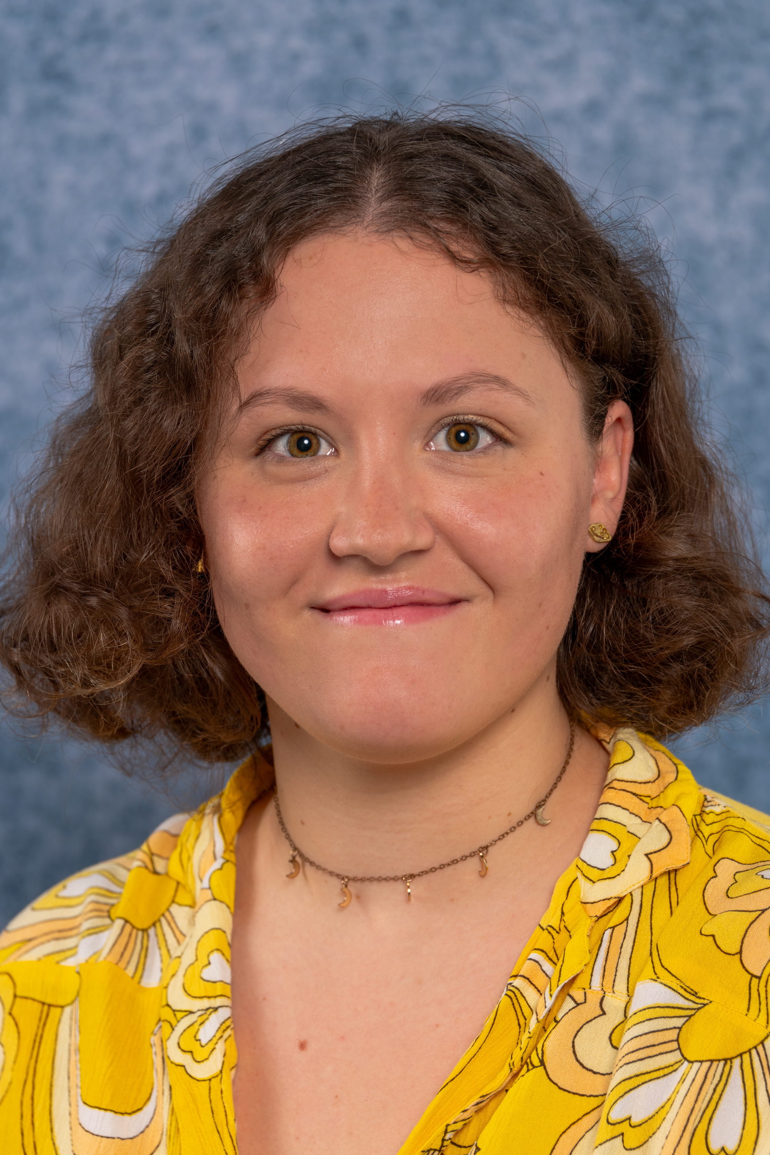
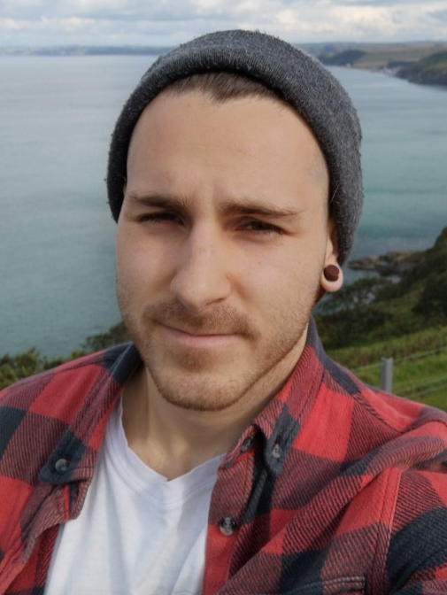
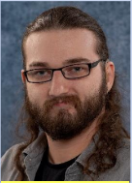
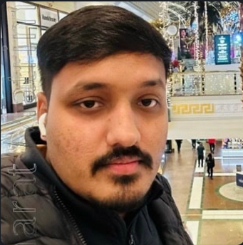
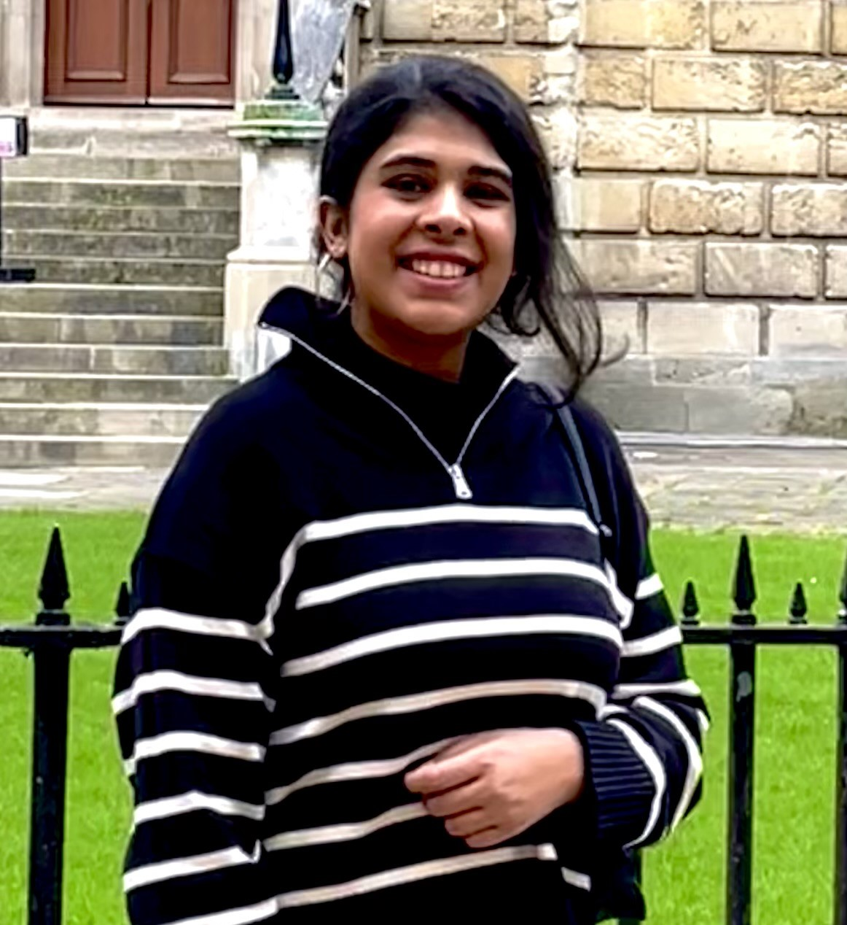
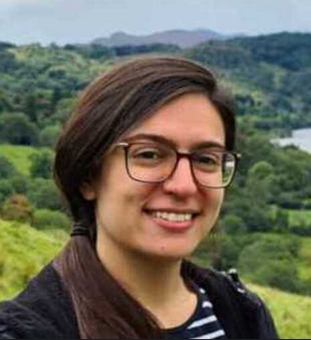
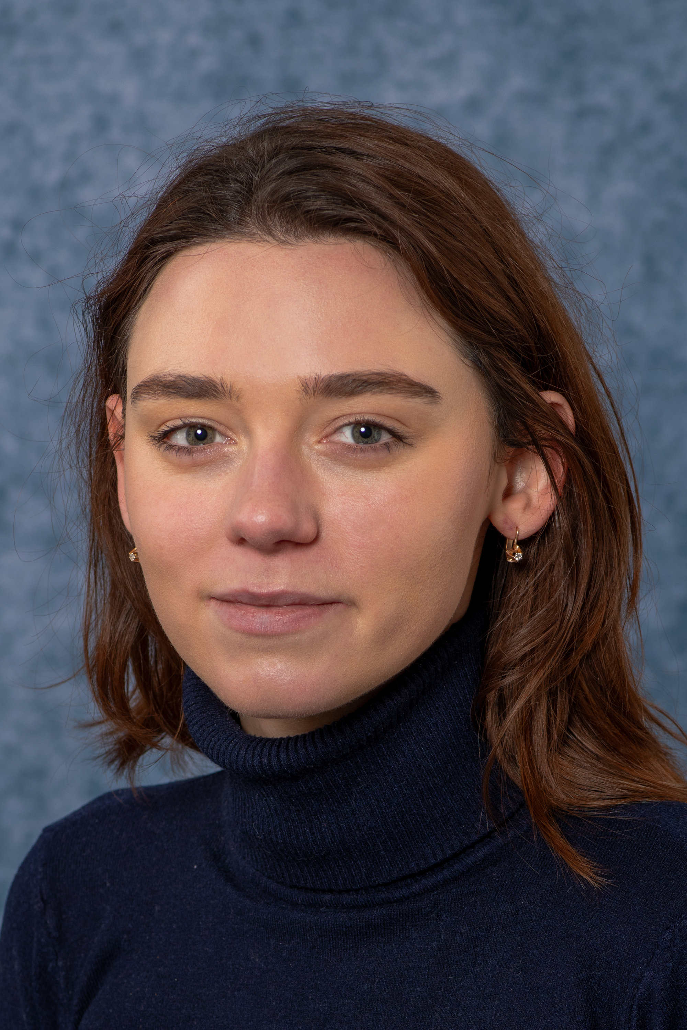
Bethan Perkins
Team Lead
Rose Dickinson
Tech Lead
Jens Jensen
Security Architect
CReDo
Archit Mantry
Scrum Master
Kyle Stevenson
User Liaison
Sarah Byrne
Software Engineer
Caroline Haigh
Software Engineer
Lewis Sampson
DevOps, Software
Engineer, DINI
Esther Turner
User Liaison,
Software Engineer
Jack Haydock
Software Engineer
Akhil Dubakunta
DevOps Engineer
Server Kasap
DevOps Engineer
Tom Kirkham
Science lead
Maitrayee Singh
Graduate - CReDo DET
Letizia Protopapa
Software Engineer –
collection pages
Elizabeth Mamtsits
Software Engineer – user requests
Katie Cartmell
Partnership manager
DINI
Marion Samler
Business manager
Lyndsey Harding
Administrator
Pam Slingsby
Administrator

Slide 28
Platform
Systems
Projects
Other (technical) stuff

Slide 29
Platform

Slide 30
Front end rewrite
Notification Service
External Datasets
Security Audit
"Basic" user accounts
Small User Requests
New K8S Cluster
Parameter Sweeps
Data Indexing for DINI
Collection Pages
*Arrows show dependencies not necessarily timelines

Slide 31
Parameter Sweep
We already have loop steps (parallel and sequential) that can loop over Workflows
These are limited to 50 iterations
Parameter sweep for a model:
Raises the iteration limit for a single model to ~10,000
Parameter sweeps are only parallel
Models have to be modified to work with sweep steps
To output data in such a way that iteration’s files don’t clash
Cannot sweep over datasets
Specified as a parameter set for a model
Expected finished by end of September

Slide 32
Parameter Sweep

Slide 33
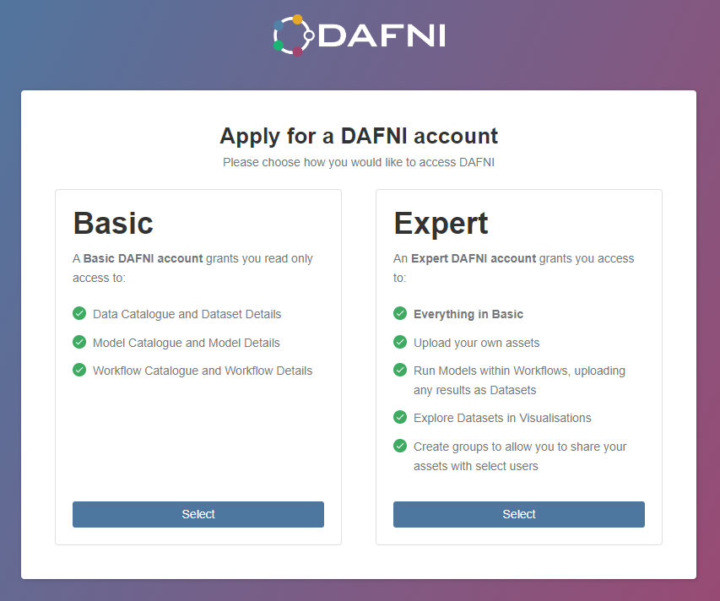
Basic User Accounts
Allow non-verified users read-only access of the platform.
Share results with invited people – invite by email
"Basic accounts" cannot run workflows
"Basic accounts" cannot use Jupyter notebook visualisation
To enable this we need to increase security of DAFNI

Slide 34
Basic User Accounts - Dependencies
Front-End Re-write
The Framework we use to build the DAFNI web app is old and is approaching end of life
To ensure security of DAFNI for Basic User Accounts we need to upgrade it
At the same time, we will be doing a “refresh” of the app to improve the user experience
Security Audit
Over the past year we have audited DAFNI’s code to remove potential vulnerabilities
This also increases security to enable us to allow Basic User Accounts
New K8S Cluster – will be talked about later

Slide 35
Collection Pages
Major piece of feedback – How do I shout about the amazing work I have done on DAFNI? The answer:
Collection Pages!
These will be visible to everyone on DAFNI, eventually may even be featured publicly on dafni.ac.uk
A space for you to
Explain your project/research
Upload images like logos and diagrams
Highlight key DAFNI assets in your research
Acknowledge your funding bodies
Link to related publications

Slide 36
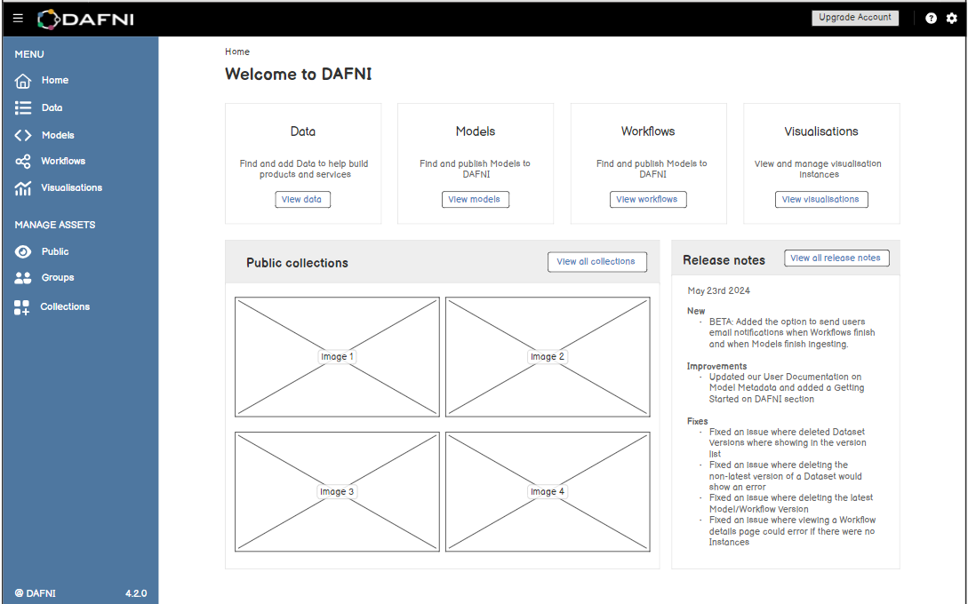
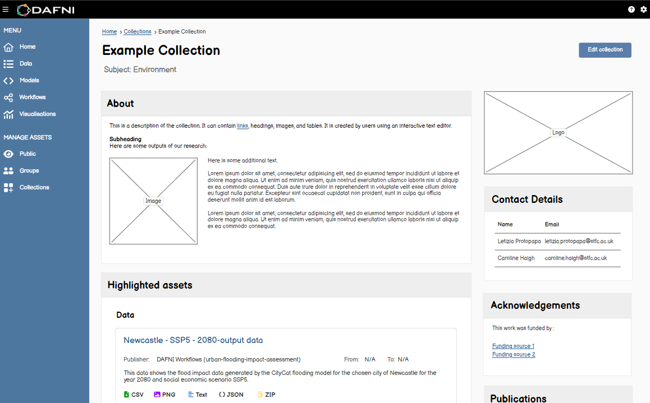
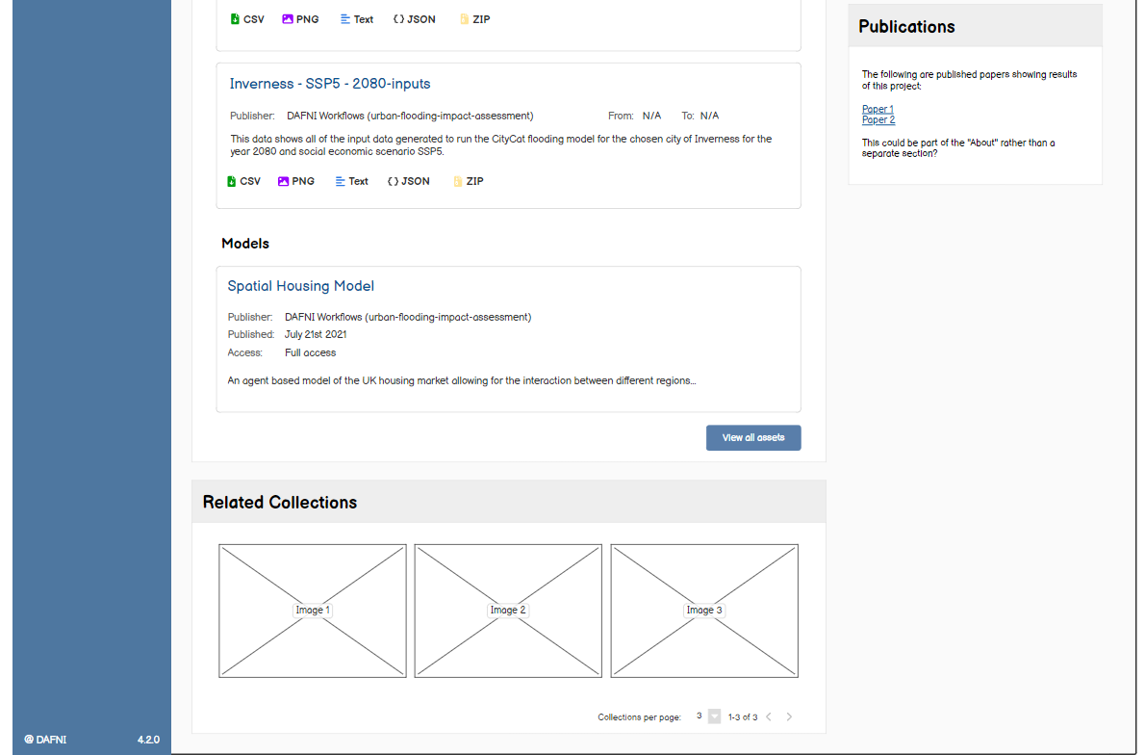
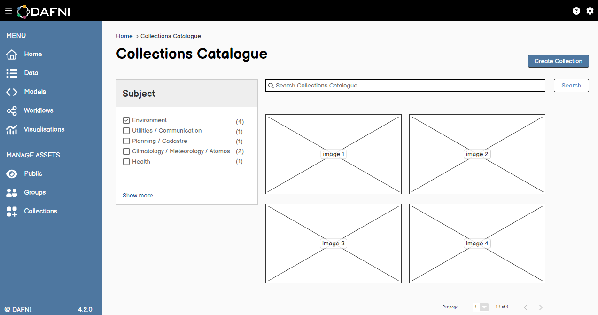

Slide 37
External Datasets
Allow users to access datasets from outside of DAFNI
Building blocks for allowing larger read-only datasets as part of a model run e.g. UKCP18
Create update to workflows back-end, allowing data volumes to be mounted to the running container, rather than copying in.
DAFNI Data Service (NID)
Data A
Data B
Data C
Model 1
Model 2
DAFNI Workflow

Slide 38
External Datasets
Allow users to access datasets from outside of DAFNI
Building blocks for allowing larger read-only datasets as part of a model run e.g. UKCP18
Create update to workflows back-end, allowing data volumes to be mounted to the running container, rather than copying in.
DAFNI Data Service (NID)
Model 1
Data B
Data C
Data
Source
Model 2
Data A
DAFNI Workflow

Slide 39
Notifications and Small Features
Notifications
Adding transactional email notifications to DAFNI
You will be able to configure which emails you receive
Existing users have been asked to re-accept T&Cs
Emails on
Dataset/Model Upload
Workflow finishing
Maintenance notifications
Small User Requests
We have received lots of requests for small changes or new features on DAFNI
A project is being taken on over the next 6 months to address as many of these as we can – keep an eye on the DAFNI release notes!

Slide 40
Systems

Slide 41
Current System Development Overview
New K8S Cluster
Move to Cloud-Hosted
Upgrade VM Host

Slide 42
New K8S Cluster
New Kubernetes cluster to host DAFNI
We hope to be moving onto this cluster before the end of the year
But why should you care?
Our current cluster is quite old now and was built during Kubernetes’ infancy. The new cluster has been built with current best-practice
Maintenance and upgrades should be easier, less risky and less noticeable to you
The move to the new cluster will unblock a lot of exciting features!

Slide 43
New K8S Cluster
Workflow Logs
"Basic" user accounts
Workflow Scheduling
Self-Hosted DAFNI
Large External Datasets
Scratch spaces
Move to STFC Cloud

Slide 44
Move to Cloud-Hosted
Moving off the DAFNI Hardware to STFC’s Cloud Environment
And other hosted-services
But why should you care?
Taking advantage of dedicated support teams
Frees up time for DAFNI’s team members to focus more on improving DAFNI
The move to STFC’s Cloud will unblock exciting features!
DAFNI-CEDA link
Cloud Bursting Workflows

Slide 45
Supporting CReDo
DAFNI hardware
cloud hosted
Azure
Normal DAFNI platform
Normal DAFNI
New Cluster
CReDo Milestone
Normal or Basic
DAFNI User
CReDo proxy
Core CReDo platform
(controlled data)
CReDo IdM
Asset Owner
CReDo apps
CReDo infra
modeler

Slide 46
Supporting CReDo
CReDo – led by Connected Places Catapult
CReDo Transport
Further OFWAT work
CReDo OFGEM SIF Beta
Synthetic data to help people explore CReDo – on Normal DAFNI
Beta programme of continuous "security vs usability" improvements

Slide 47
CReDo Future Future Vision
DAFNI
Infrastructure Digital Twin
Climate data repo
Climate HPC (JASMIN)
One way arrow
We would like to investigate existing commercial data sharing "solutions" in DINI
Asset Owner 1
Asset Owner 2
Asset Owner 3

Slide 48
Other (technical) stuff

Slide 49
Technical User Group (TUG)
What?
Led by Sarah Byrne
Preview of features, preview of development roadmap, early release testing, technical discussions and prioritisation
Your opportunity to give us feedback on UI choices and contribute to prioritisation discussions.
When?
Approximately quarterly meetings – has met 3 times since last conference
No requirement to attend all meetings, agendas circulated beforehand
Next one currently being scheduled

Slide 50
Technical User Group (TUG)
Previously consulted on features include:
Collections pages – page content
External datasets – page content / UI choices / usage
Parameter sweep workflow steps – usage / iteration limits
User notifications – functionality / usage
Small user requested features – prioritisation
Interested in joining? Come and find Sarah in one of the breaks!

