Slide 1


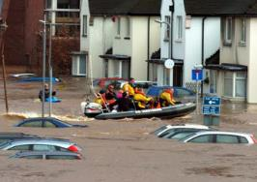
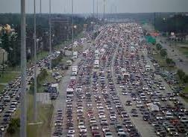
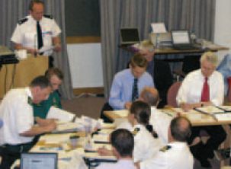
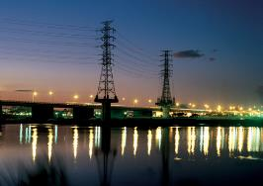



An Agent-Based Model of Flood Infrastructure Resilience
Richard Dawson
Janetta Steyn, Robin Wardle, Michael Jones, Olivia Butters
richard.dawson@newcastle.ac.uk
@profrichdawson
richard-dawson-newcastle

Slide 2
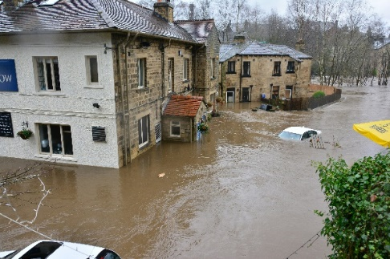
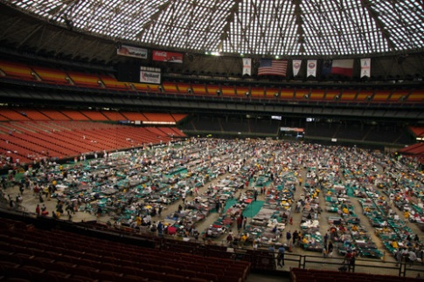
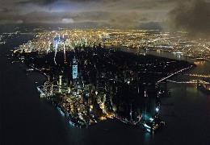
Flood resilience
Flood risk assessments typically look at probability and damages
Why do some floods generate higher damages or lead to greater loss of life – even in the same location?
Why are some communities ‘back on their feet’ much more quickly?
Role of individuals, communities, organisations in mediating short term risks and preparing for long term risks are crucial
Resilience to a flood event does not just come from big flood defences but timely warnings, temporary barriers, evacuation
Resilience is also enabled and enhanced by land use planning, design and operation of infrastructure networks etc.
Photo: Chris Gallagher
Photo: Eon Images
Photo: Iwan Baan

Slide 3
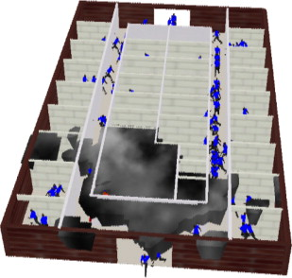
ABM to capture flood incident responses
Spatial data:
  Flood defences
Ground elevation
Transport network
Property type and location
etc.
Behaviour rules:
  Normal interaction
Response to warning
Response to floodwater
etc.
Resilience actions:
  Evacuation strategy
Flood warning etc.
ABM Platform
Hydrodynamic simulation
Agent simulation
Event conditions:
  Storm surge
Failed defence
Time of day etc.
Vulnerability information:
  Economic
Drowning
etc.
Risk analysis

Slide 4
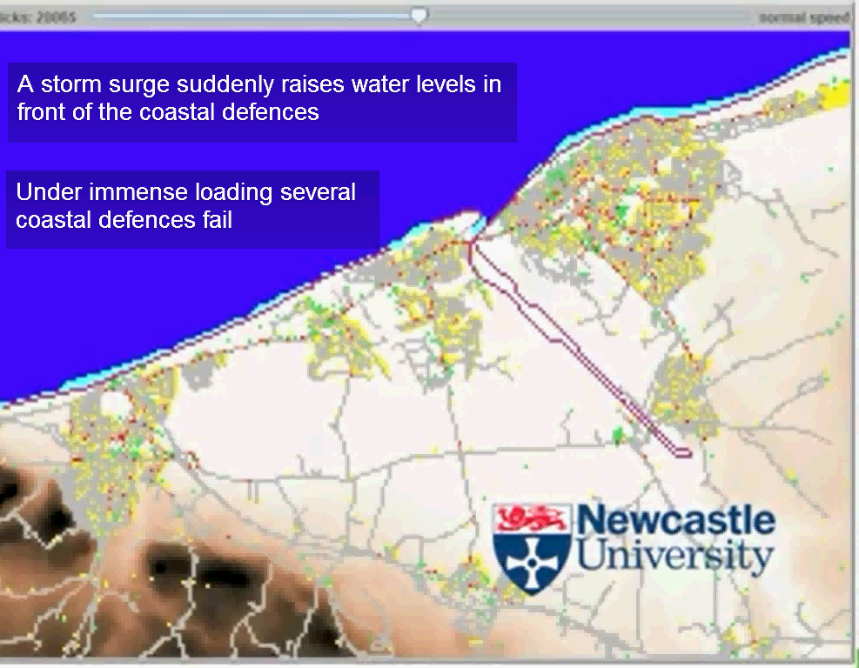
http://www.youtube.com/watch?v=o0EOlc5n9O8
Dawson, R. J., Peppe, R. and Wang, M. (2011) An agent based model for risk-based flood incident management, Natural Hazards, 59(1):167-189 (doi: 10.1007/s11069-011-9745-4).

Slide 5
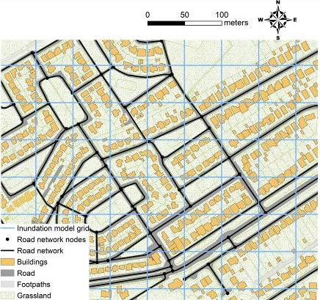
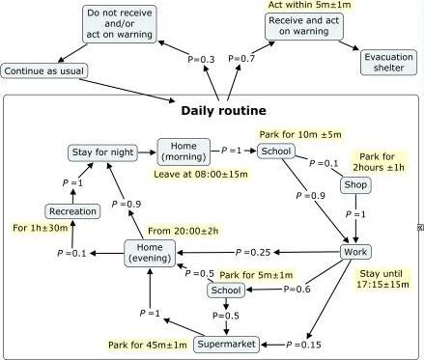
Geospatial behaviour model for different demographic and agent types

Slide 6
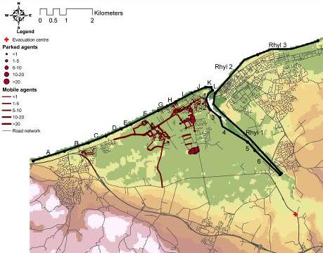
Spatial impacts: Single defence breach
Breach location

Slide 7
Risk to people vs. property
Rank | Population | Economic
1 | I | B
2 | H | C
3 | J | E

Slide 8
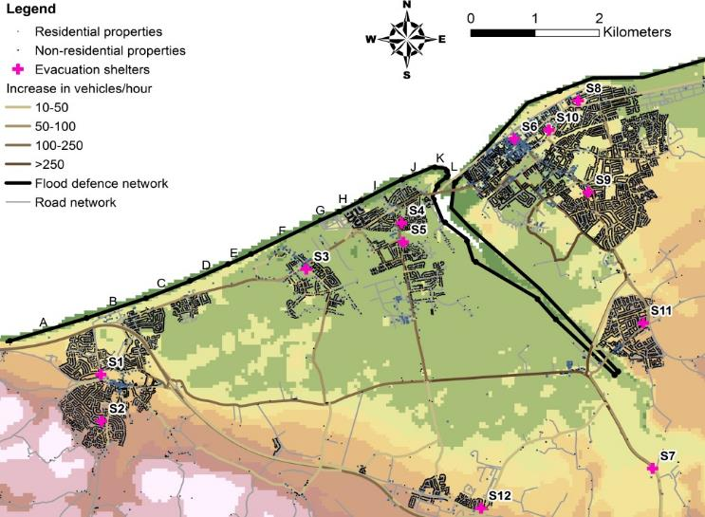
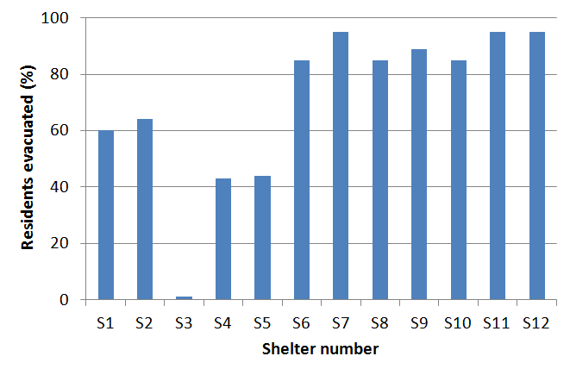
Evacuation location
Breach location

Slide 9
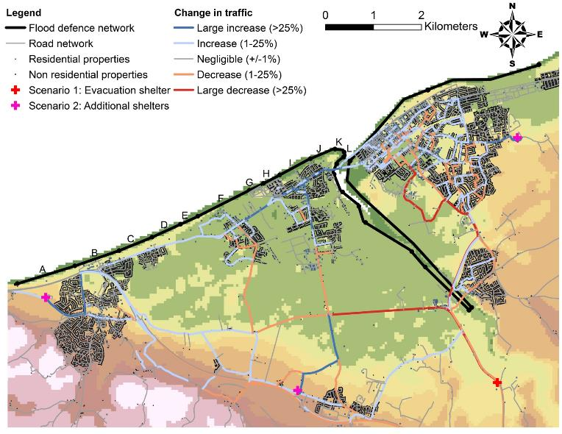
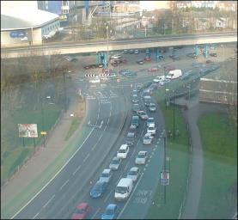
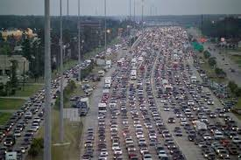
Congestion
Coventry, 2008
Breach location
Houston, 2005

Slide 10
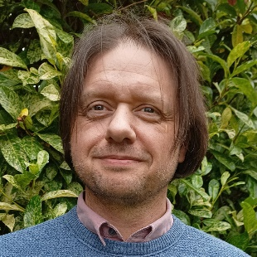
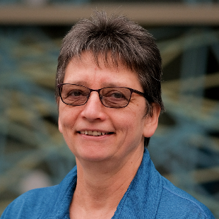
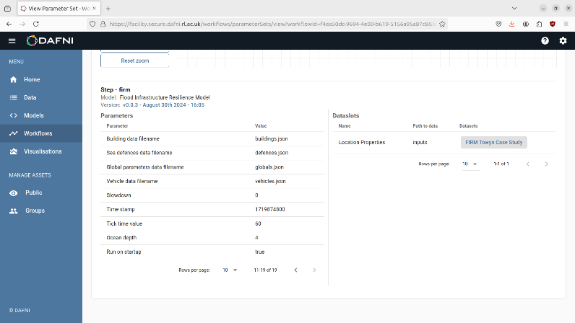
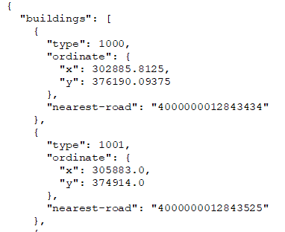
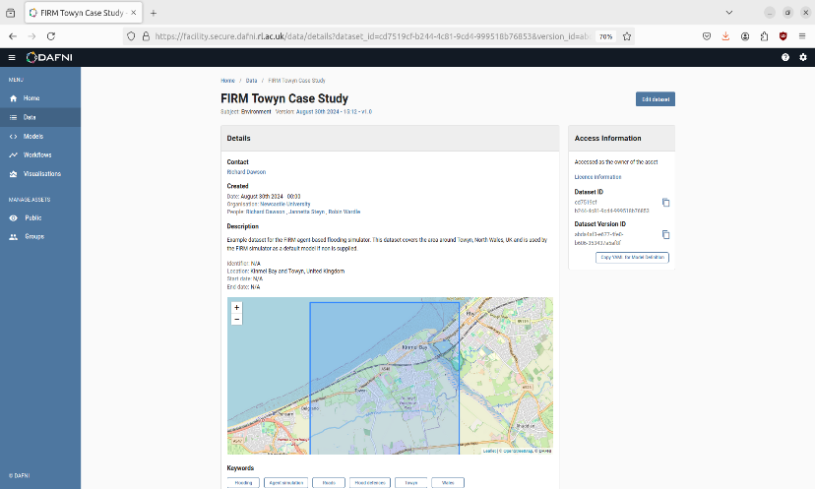
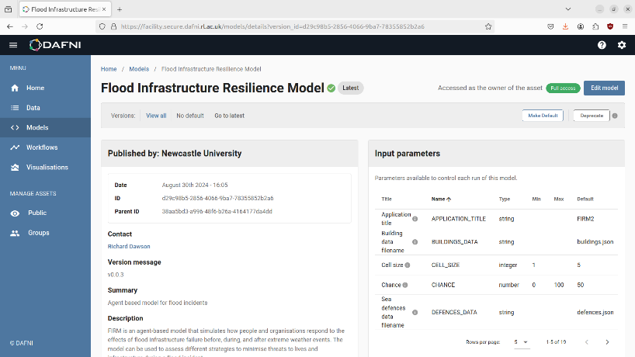
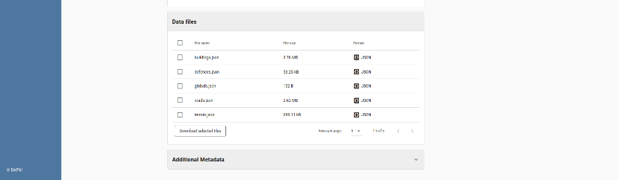
Centre of Excellence project
Model workflow in DAFNI
Standardised input data (*.json)
Example datastet (Towyn)
Robin Wardle
Jannetta Steyn

Slide 11
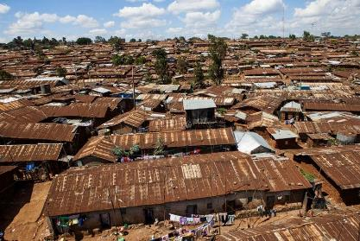
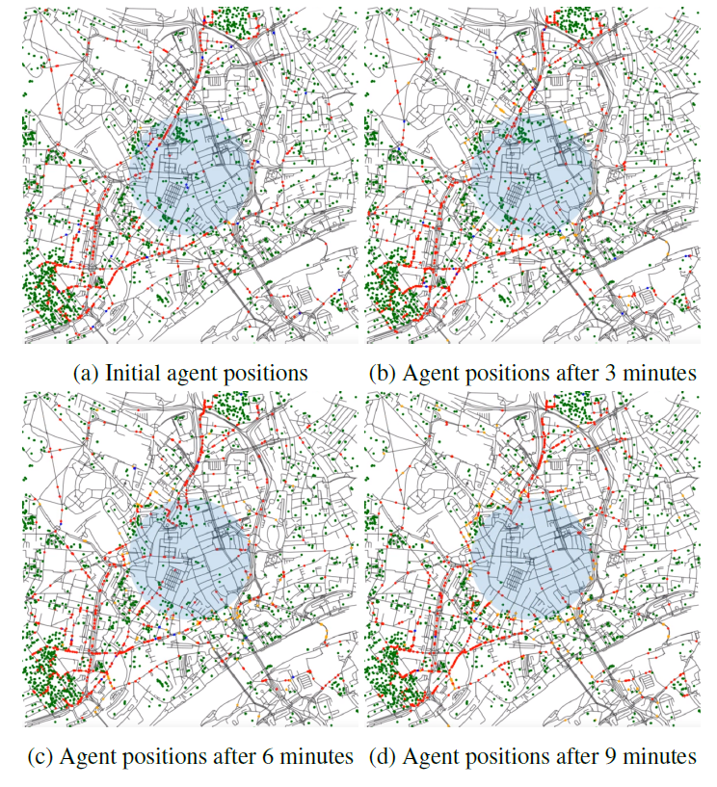
Further development and application
Different hazards Informal settlements
People / m road length

Slide 12
An Agent-Based Model of Flood Infrastructure Resilience
richard.dawson@newcastle.ac.uk
@profrichdawson
richard-dawson-newcastle

